Slide 1
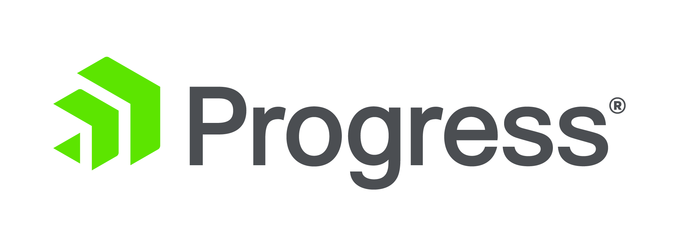
Introducing NativeScript
An open-source framework for building truly native mobile apps with Angular, TypeScript or JavaScript.
Notes:
This is a simple title slide; you can customize if you’d like.

Slide 2



TJ VanToll
Jen Looper
Sebastian Witalec

Slide 3
Agenda!
Slides and Q&A
9:00 AM – 9:30 AM
Warmup Exercises
9:30 AM – 12:00 PM
Build an app
1:00 PM – 4:00 PM

Slide 4
Early prototypes
“Core” engineering
Public launch
Adoption ramp-up
Mass adoption
2013
2014
2015
2016
2017
Project Timeline
Notes:
NativeScript has been in development for over four years; was first released to the public in March of 2015; and has been growing ever since.
---
If you’d like to give a bit of a history lesson during your slides you can talk about how NativeScript started as a project at Telerik in 2013. Telerik was (and still is) building a lot of tooling for Apache Cordova and PhoneGap applications, and was finding a number of limitations—most notably performance and the difficulty of doing native-y things.
NativeScript was borne out of a desire to build a framework that let you use JavaScript to build mobile apps, without the performance and usability limitations inherent to Cordova development.
Telerik was acquired by Progress in December of 2014 (thus the Telerik → Progress name change).

Slide 5
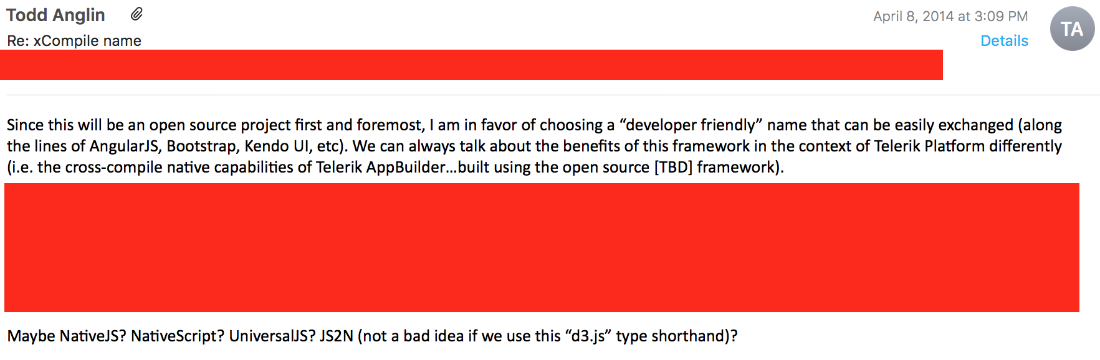

Slide 6
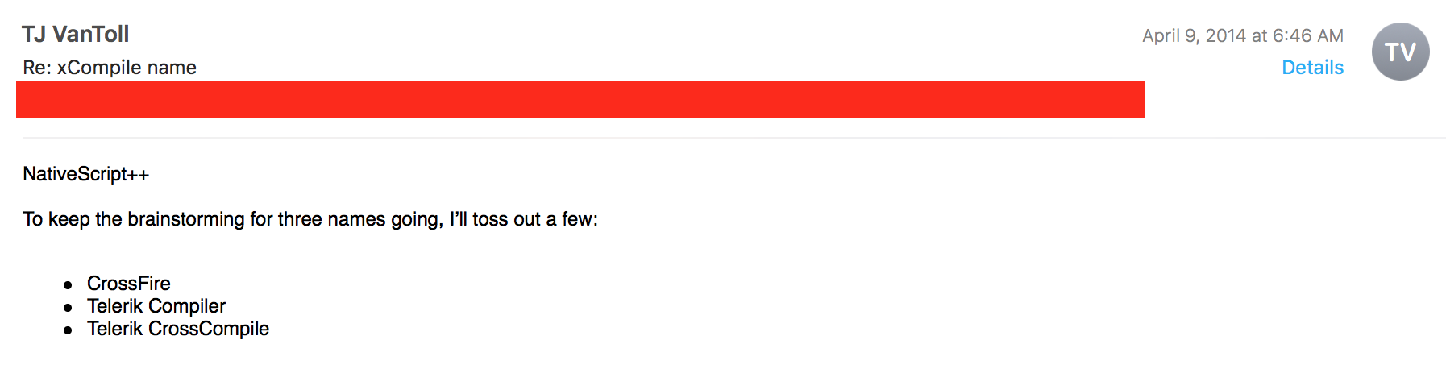

Slide 7
Hybrid
100% Web
Hybrid
100% Native
Reach
Code/Skill Reuse
Richness
Premium experience
Device APIs
Best of both?

Slide 8
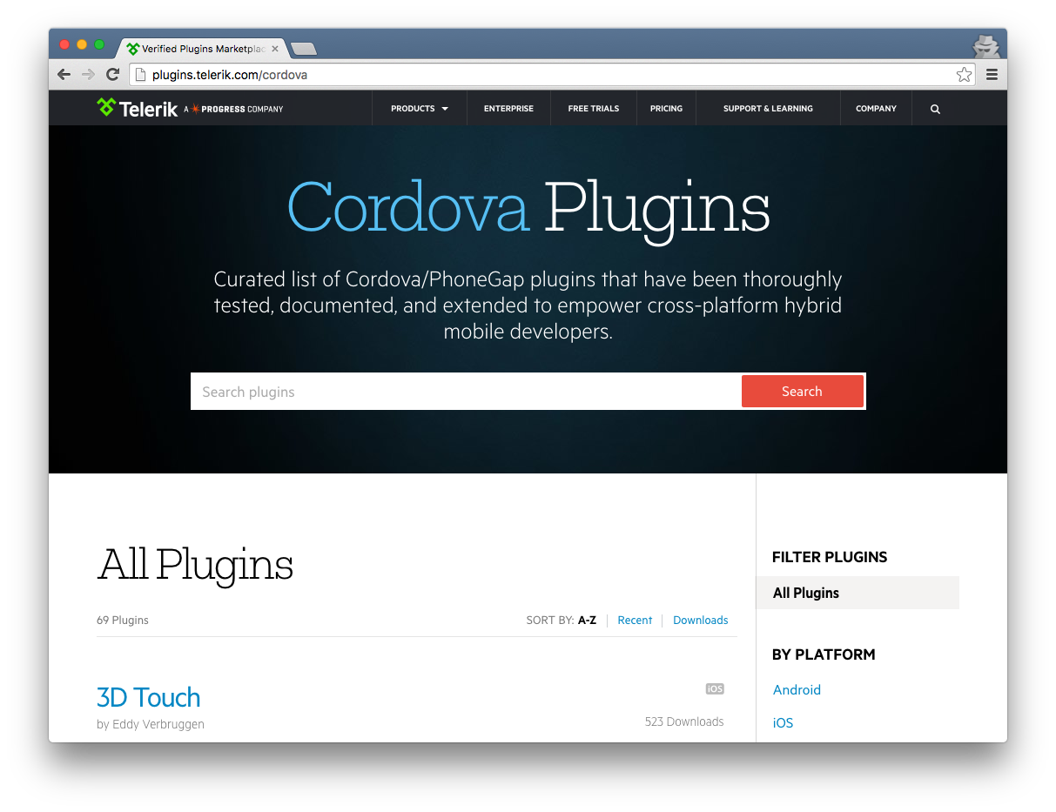

Slide 9
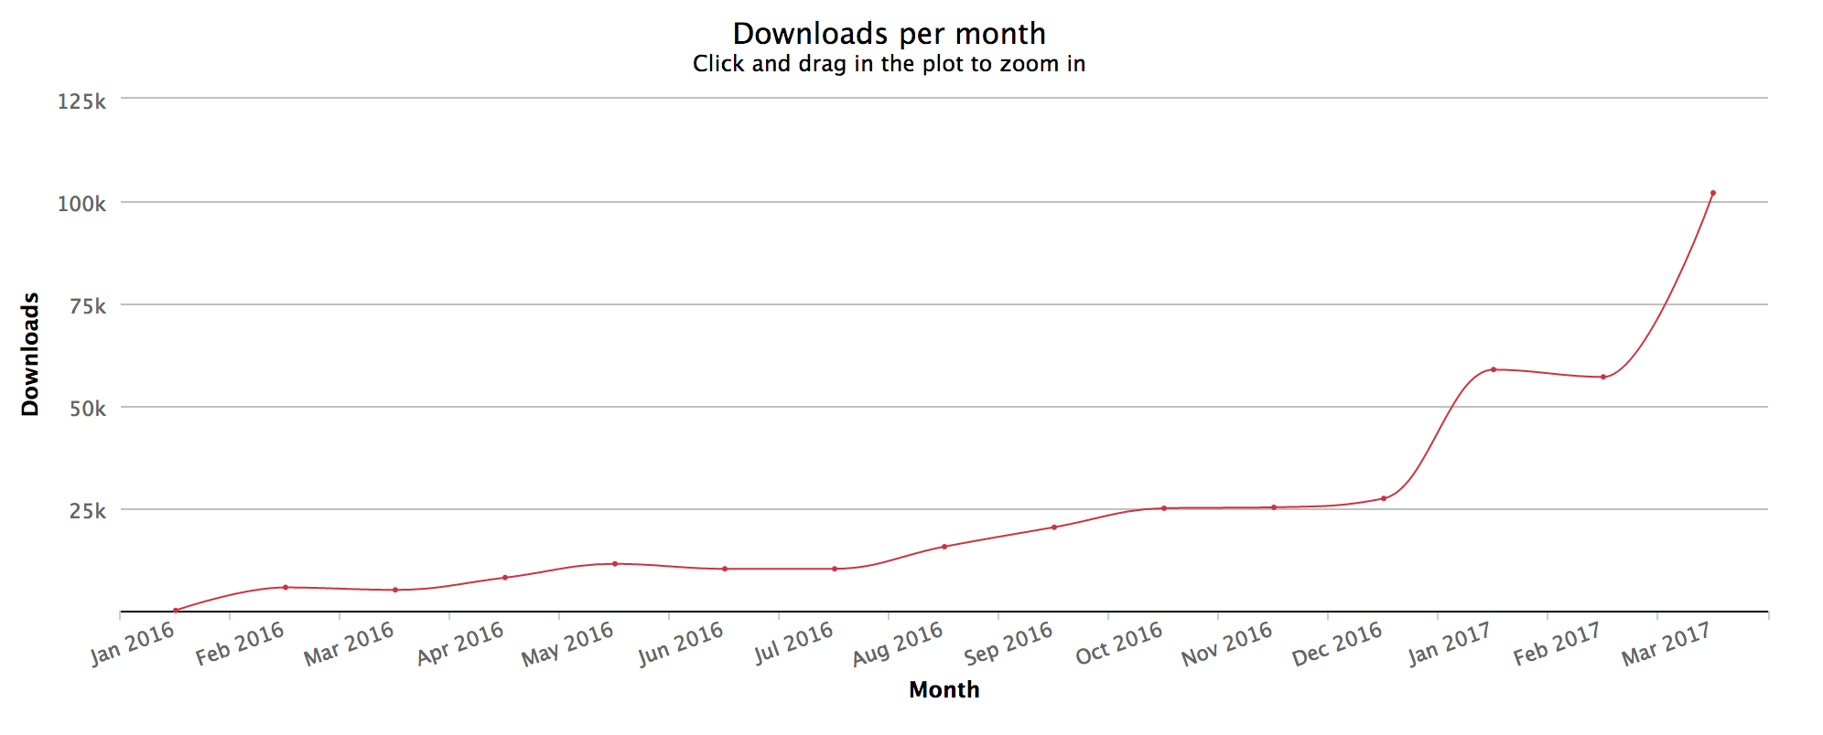
npm downloads of the “nativescript” package
https://npm-stat.com/charts.html?package=nativescript&from=2016-01-31&to=2017-03-31
Notes:
This slide shows npm downloads of the “nativescript” npm package for one full year. The slide backs up the previous slide’s claim that 2017 is a year of mass adoption for NativeScript. You may wish to update this chart with new data at npm-stat.com—follow the link on the slide and update the dates in the dropdowns.

Slide 10
NativeScript is the best tool for cross-platform native app development 🎉
Notes:
This is the thesis that the rest of the slide deck aims to prove.

Slide 11
5 reasons

Slide 12
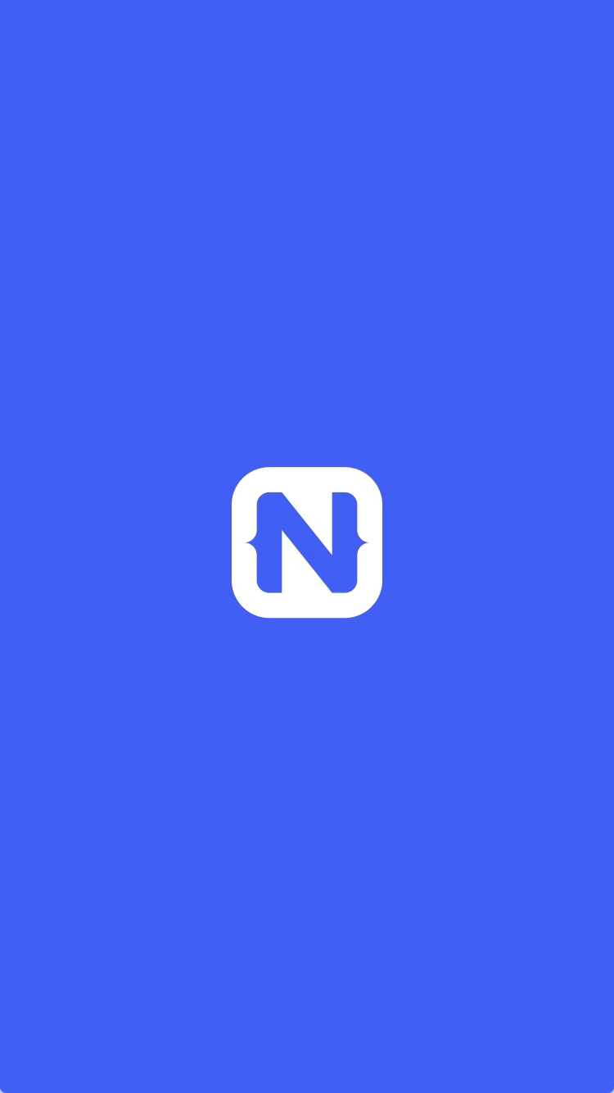
1
Rich, animated, “no compromise” native UI
(with shared UI code)
Search for
“Examples NativeScript”
in the iOS App Store or Google Play to try this app out for yourself.
Notes:
With NativeScript you build interfaces using truly native UI components. NativeScript does not use HTML; NativeScript does not use WebViews; NativeScript does not use a DOM.
The result is iOS and Android apps that feel native—because they are. Encourage attendees to multitask and download the “Examples NativeScript” app from the iOS App Store or Google Play to see this performance for themselves.

Slide 13
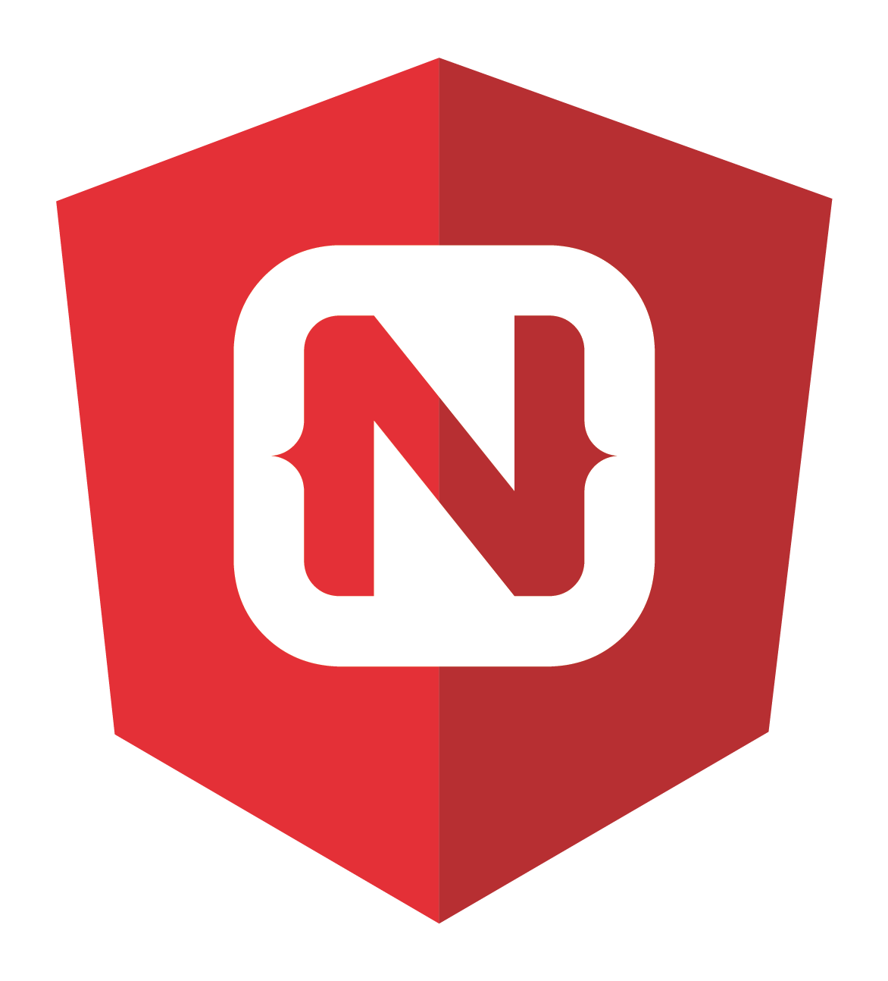
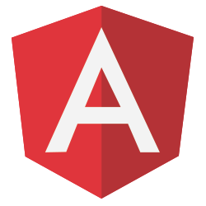

2
First-class Angular and TypeScript support
+
=

Slide 14
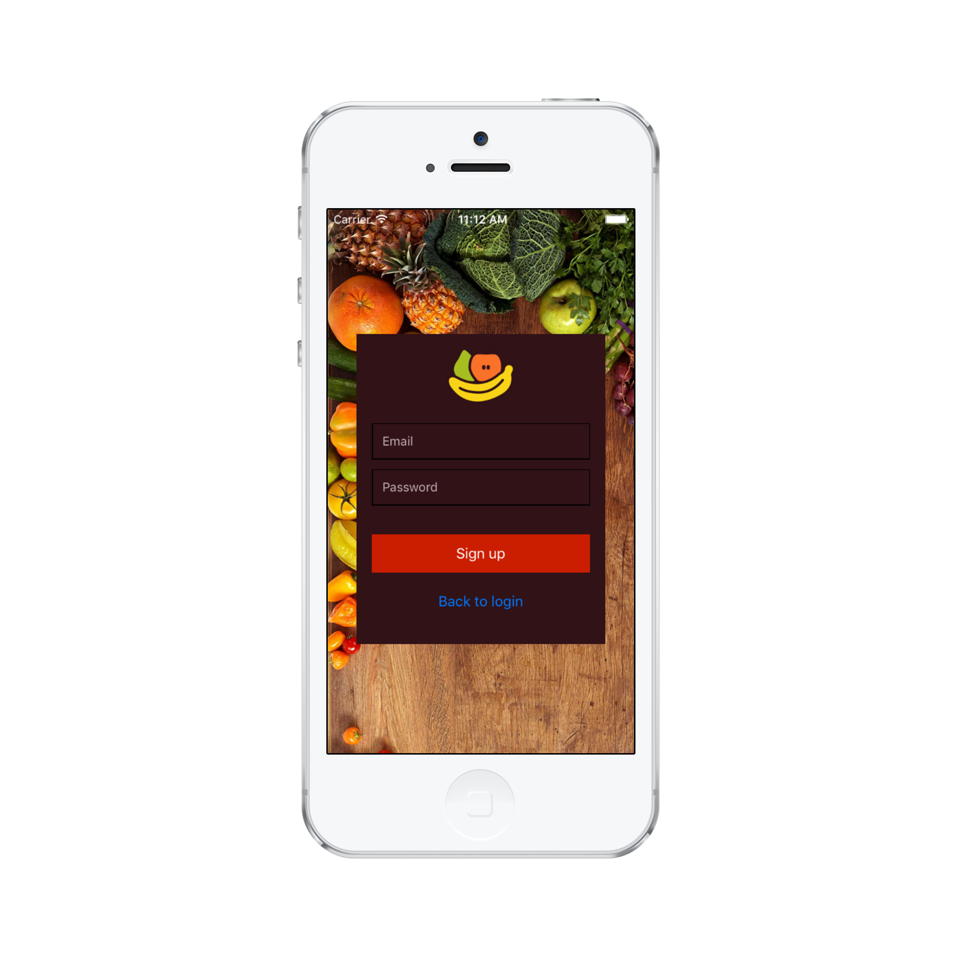
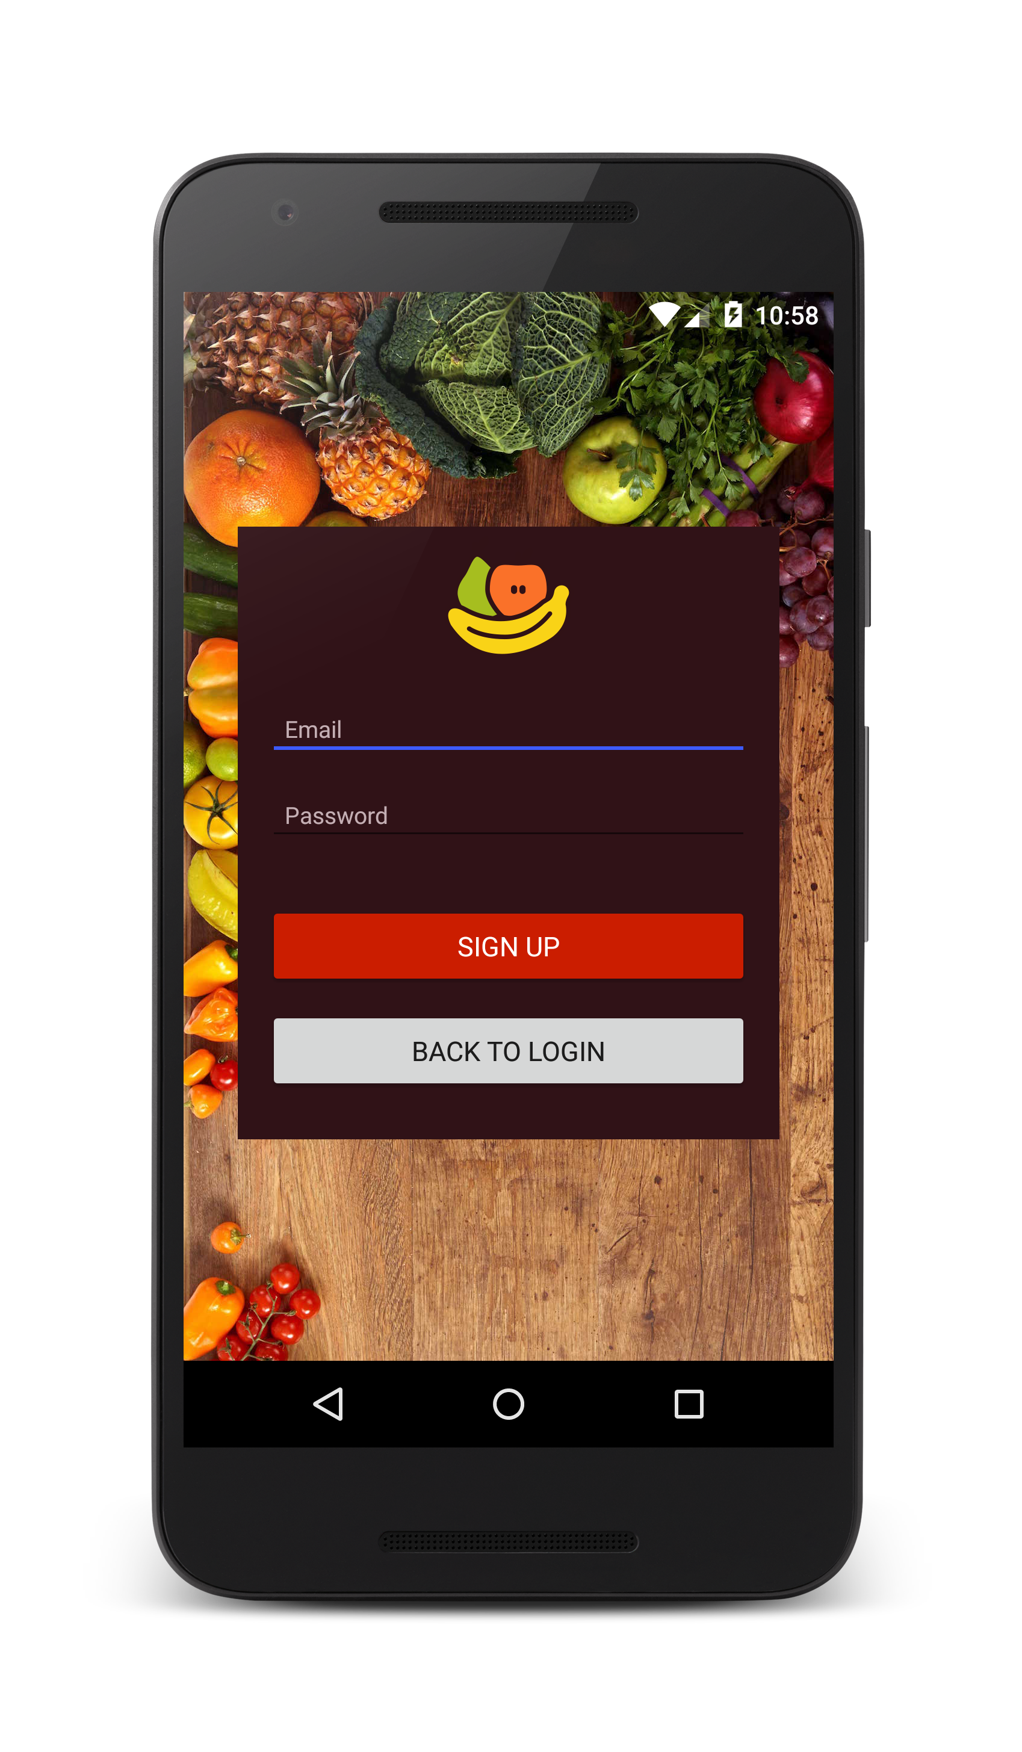

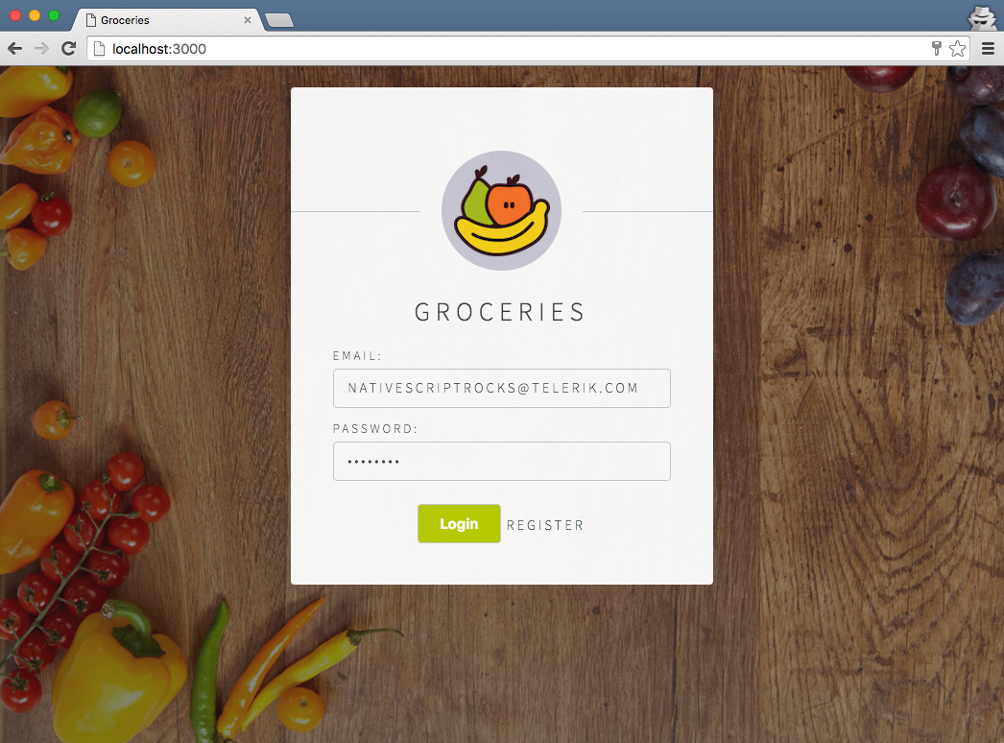
Android
iOS
Web

Slide 15
3
Ease of doing native-y things
Notes:
One of NativeScript’s guiding principles is to make it easy to do native things. The NativeScript team believes that your JavaScript-based app should have just as much power as a natively written one.

Slide 16
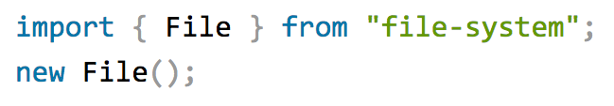

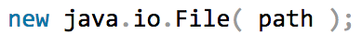

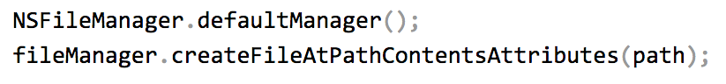
NativeScript modules
Notes:
To start NativeScript provides dozens of built-in modules that abstract complex native functionality behind simple-to-use JavaScript and TypeScript APIs. For example, to allocate a file in a NativeScript app you import a File constructor and invoke it, as opposed to writing the native code you see on the bottom of the screens.

Slide 17
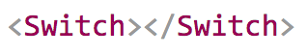
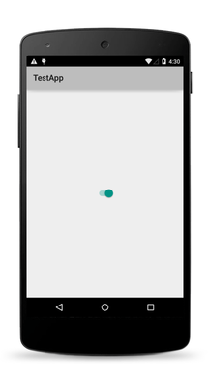
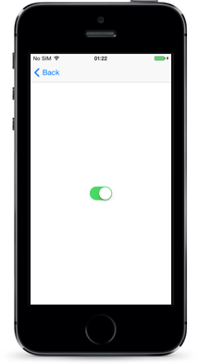
NativeScript modules for UIs
Notes:
There are a number of NativeScript modules that help you build your user interfaces in markup rather than complex native code. The slide shows the switch component, and you can find the full list at docs.nativescript.org/ui/components.

Slide 18
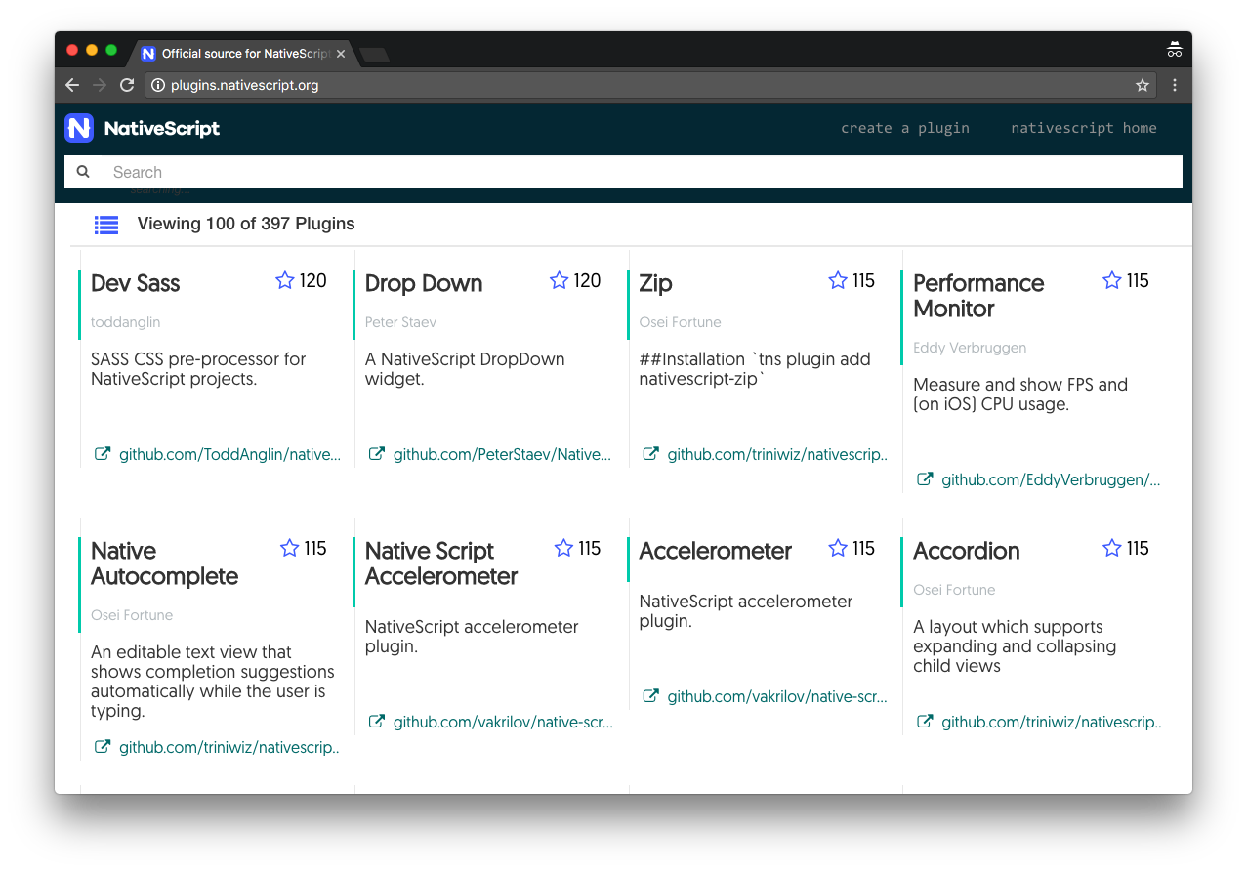
NativeScript Plugins Hub (plugins.nativescript.org)
Notes:
To build upon the built-in modules, the NativeScript community builds and maintains a robust set of NativeScript plugins—adding to the things you functionality you can quickly and easily add to your NativeScript apps.

Slide 19


Reuse existing native Android and iOS libraries
Notes:
And finally, NativeScript provides the ability to leverage native Android and iOS libraries in your applications. This includes jars from places like Android Arsenal, as well as resuable iOS libraries such as CocoaPods.

Slide 20
4
Vibrant and growing community 💖
Notes:
When you use NativeScript you join a large and ever-growing community that spans the world.

Slide 21
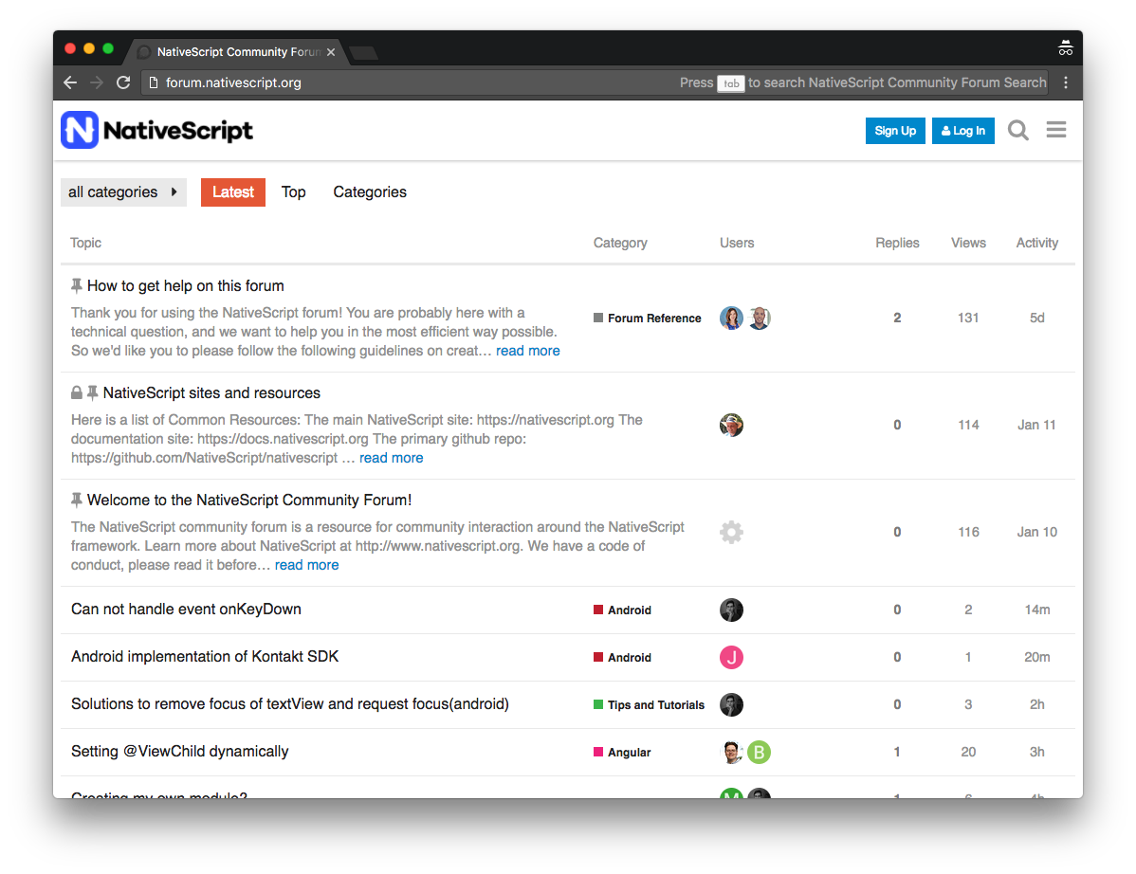
NativeScript community forum (forum.nativescript.org)
Notes:
The NativeScript community forum at forum.nativescript.org is a great place to ask questions and get help from the greater NativeScript community.

Slide 22
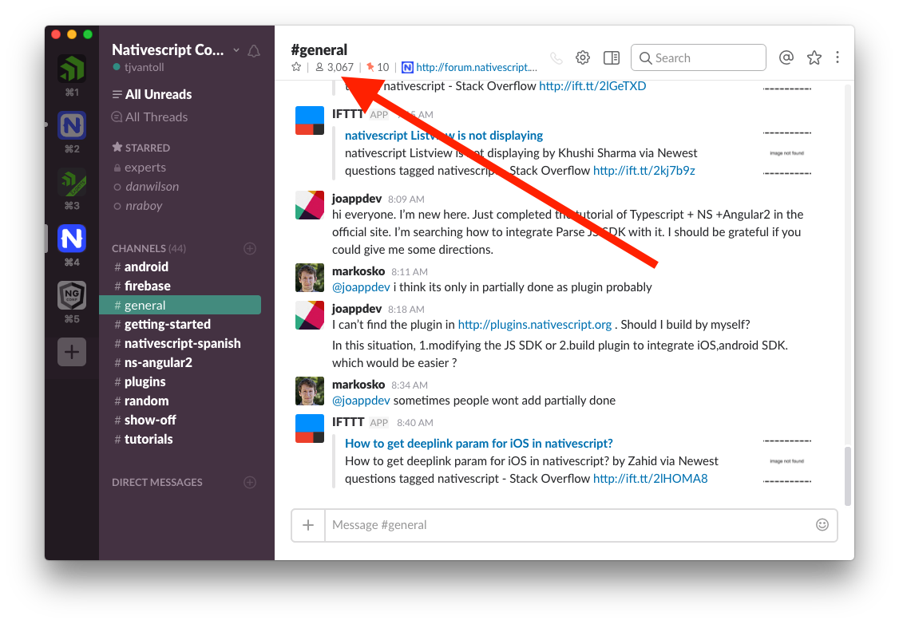
NativeScript community Slack channel
Notes:
The NativeScript community Slack channel is a great place to chat with others in the NativeScript community—over 3000 members!

Slide 23
5
Supported by a major software company vested in your success 👨‍💼👩‍💼
Notes:
NativeScript is a free and open source project, but you can rest assured that there is a major software company backing the project in full. Progress is a Fortune 500 traded company with a long history in the software industry, with well over 1000 employees all around the world.
So how does Progress make money off NativeScript? Two ways.

Slide 24
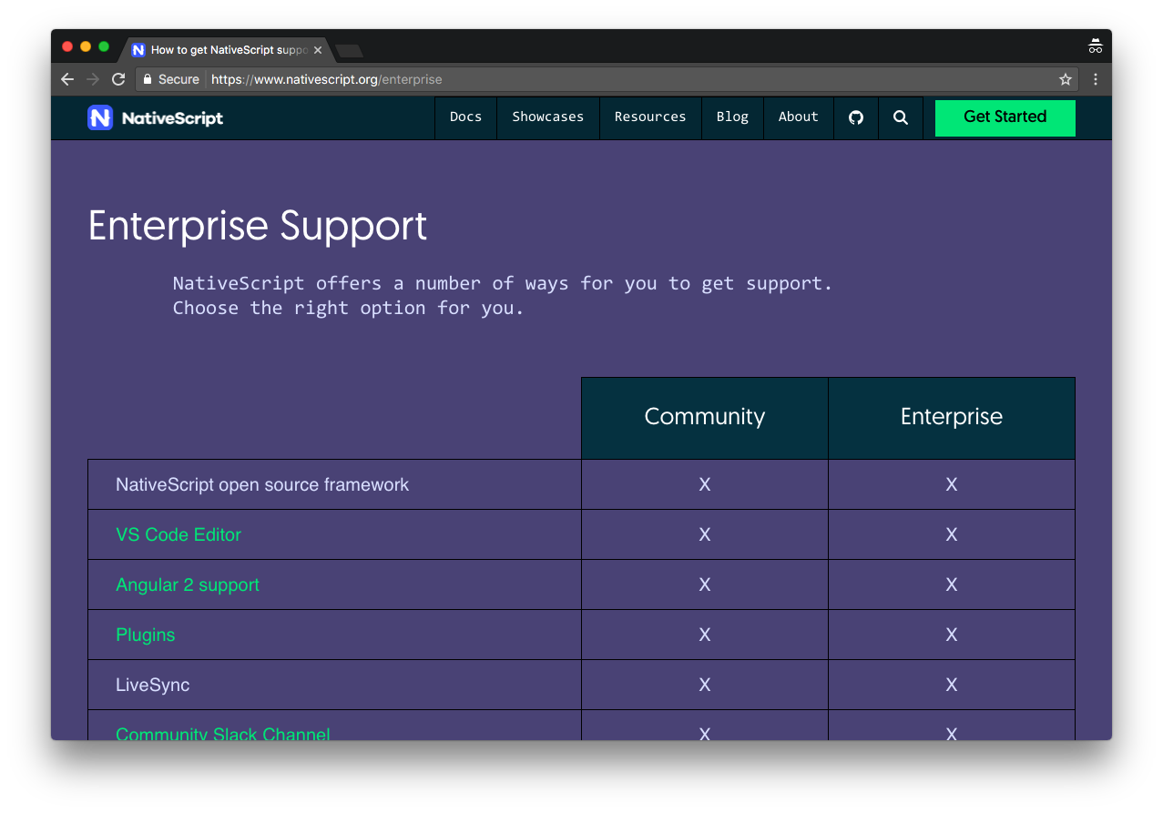
NativeScript offers enterprise support
Notes:
The first is enterprise support. If you work for a large company considering building NativeScript-based apps, the NativeScript team provides a variety of support options that can help make your app a success.

Slide 25
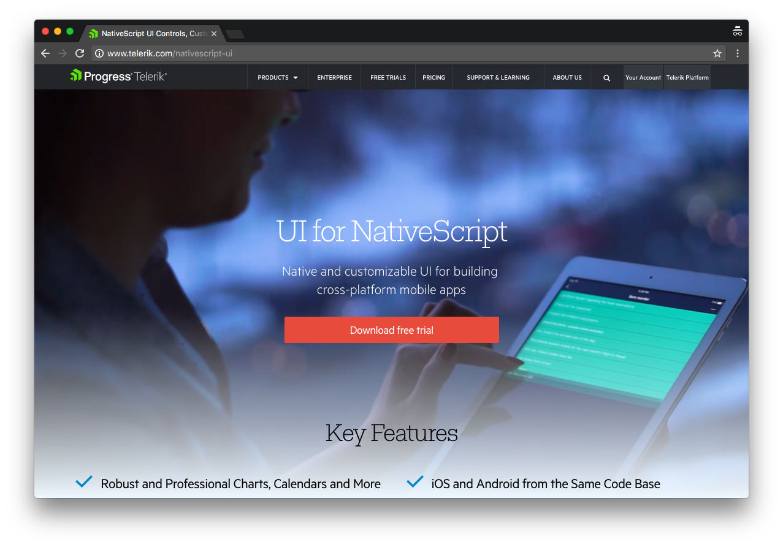
UI for NativeScript—premium UI components
Notes:
The second is premium UI components through a product named UI for NativeScript. UI for NativeScript contains a series of paid UI component, such as calendars, charts, and graphs.

Slide 26
5 Reasons to use NativeScript
1) Rich, animated native UI
2) Maximum code and skill reusability
3) Ease of doing native-y things
4) Vibrant and growing community
5) Supported by a major software company

Slide 27
NativeScript is the best tool for cross-platform native app development 🎉
Notes:
This slide repeats the slide deck’s thesis.

Slide 28
Let’s get started! 🔥
Notes:
If you are going to do a demo, this is a slide you can use to transition.
If you’re not comfortable with live coding, show something that you’ve built with NativeScript. Or just bring up a simple little app you’ve worked on and walk attendees through the files and what they do.

